Slide 1
50.003: Elements of Software Construction
Week 1
Software Development: Life Cycle and Methodologies

Slide 2
Plan for the Week
First Class: Overview of Software Engineering and Software Development Processes
Second/Third Class: More on Software Development Processes

Slide 3
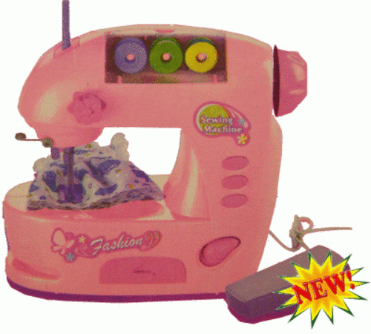
Software Engineering
User Requirements
the magical programming machine
System Implementation
***The synthesis problem (i.e., synthesizing a program from a specification automatically) is undecidable (i.e., there doesn’t exist an algorithm which could solve the problem in finite time).

Slide 4

Software Engineering
User Requirements
The species we called programmers
System Implementation

Slide 5
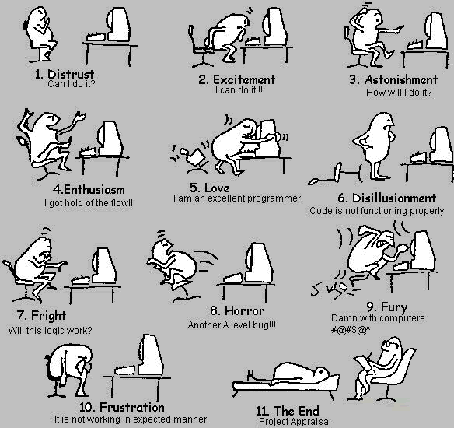
A Programmer’s Life

Slide 6
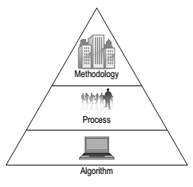
More Than Just Coding Skills
Coding Skills
where we are at

Slide 7
The Big Questions
Why are we worried about methodologies?
What is the software development life cycle (SDLC)?
What are the different software development methodologies?
How to choose one methodology over another?

Slide 8

“If you want to build a ship, don’t drum up the men to gather wood, divide the work and give orders. Instead, teach them to yearn for the vast and endless sea.”
—Antoine de Saint-Exupery

Slide 9
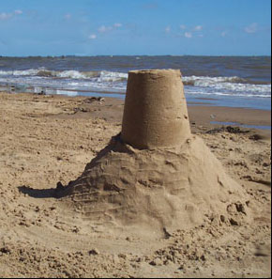

Slide 10


Slide 11
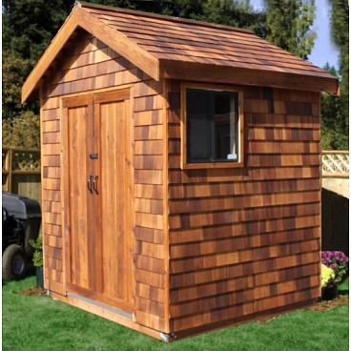

Slide 12


Slide 13


Slide 14


Slide 15
More Than Just Coding Skills
Coding Skills
where we are at

Slide 16
Discussion
You have a sense of the course project by now. If you don’t, please make sure you do ☺
Discuss for 3 minutes on how you plan to carry out your project.

Slide 17
Methodologies
Code-a-bit-test-a-bit (CABTAB)
Waterfall
Rapid prototyping
Iterative and incremental
Spiral
Agile methods

Slide 18
CABTAB
Code-a-bit-test-a-bit (CABTAB) is hardly recognized as a methodology, although it is widely used in programming.
It is unsuitable for anything other than very small systems of limited scope.
We need a process!

Slide 19
Software development life cycle (SDLC)
The SDLC is the sequence of activities covering
requirements
analysis
design
implementation
testing
over which a software system is developed.

Slide 20
Requirements
During the requirements workflow, the primary activities include
Listing candidate requirements
Understanding the system context through domain modelling and business modelling
Capturing functional as well as non-functional Requirements
Requirements should be captured in the language of the user.
Use cases help distil the essence of requirements as sets of action-response transactions between the user and the system (e.g., as user cases).

Slide 21
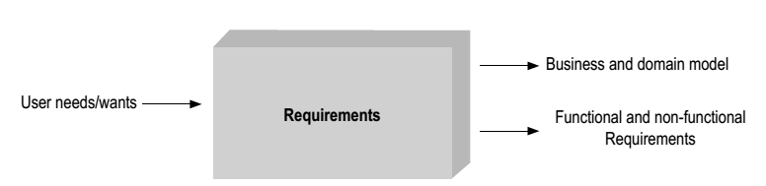
Requirements
A functional requirement is one on the functionality of the system, e.g., the system must book the movie ticket for the user at the specific time.
A non-functional requirement is one on the performance of the system, e.g., the system must book the ticket within 2 minutes.

Slide 22
Analysis
A key theme of the analysis workflow is to understand how and where requirements interact and what it means for the system.
Analysis also involves
Detecting and removing ambiguities and inconsistencies amongst requirements
Developing an internal view of the system
Identifying the analysis classes and their collaborations
Analysis classes are preliminary placeholders of functionality

Slide 23
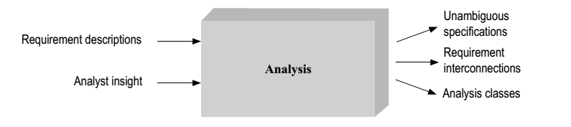
Analysis

Slide 24
Design
Deciding on the collaboration between components lies at the heart of software design.
A component fulfils its own responsibility through the code it contains.
A component exchanges information by calling methods on other components, or when other components call its own methods.

Slide 25
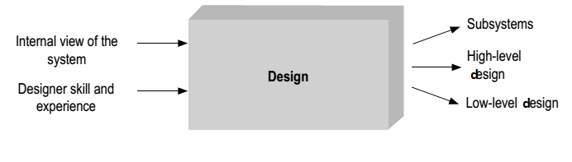
Design
The design workflow involves
Considering specific technologies
Decomposing the system into implementation units

Slide 26
Implementation
A large part of implementation is programming.
Implementation also involves
Unit testing
Planning system integrations
Devising the deployment model

Slide 27
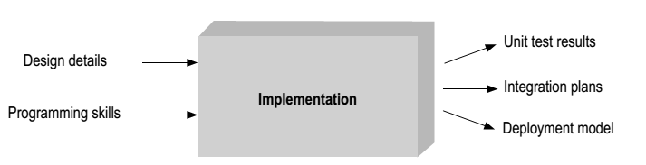
Implementation

Slide 28
Testing
The primary activities of the test workflow include
Creating test cases,
Running test procedures, and analysing test results.
Due to its very nature, testing is never complete.

Slide 29
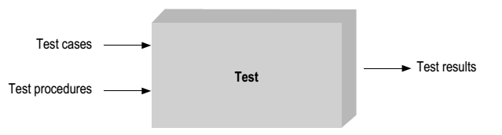
Test

Slide 30
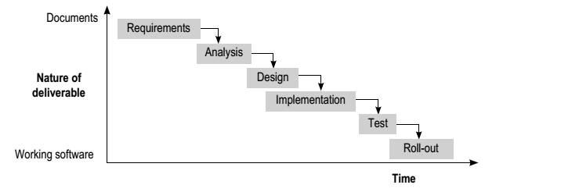
Waterfall model

Slide 31
Waterfall model
The Waterfall model uses the metaphor of falling water to underline the sequential nature of software development.
It is suited to projects of limited uncertainly and risks.

Slide 32
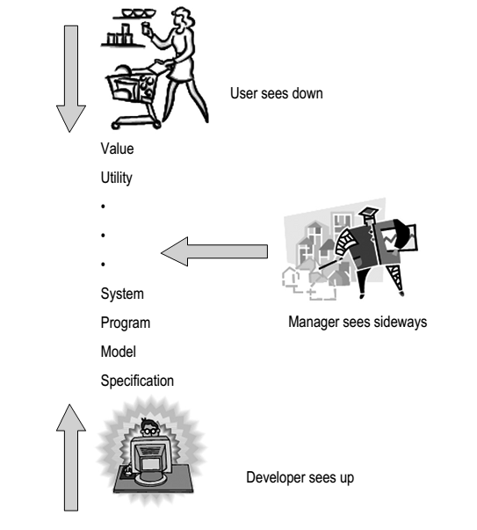
Waterfall Model: Problems
What do I want?
How do I do it?

Slide 33

Waterfall Model
Click Here

Slide 34
Cohort Exercise I (10 min)
In his 2000 Turing lecture ‘The Design of
Design’, Frederick Brooks said, ‘The Waterfall Model is Dead Wrong’. I suppose you would agree to certain extent.
The waterfall model assumes that the different stages of software development are sequential. Discuss with your group on the actual relationship between the 5 activities in SDLC + the stage of maintenance.

Slide 35
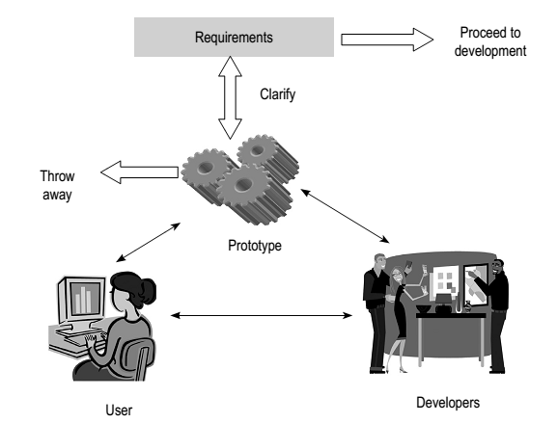
Rapid Prototyping

Slide 36
Rapid Prototyping
Rapid prototyping recommends the building of prototypes to clarify requirements and system scope.
The prototypes, however, should never become the final system.

Slide 37
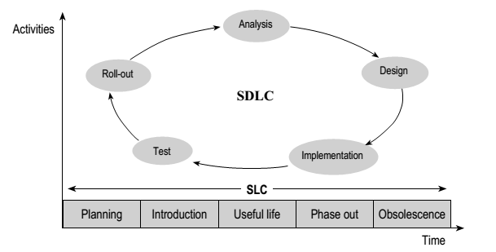
Software Development Life Cycle versus Software Life Cycle

Slide 38
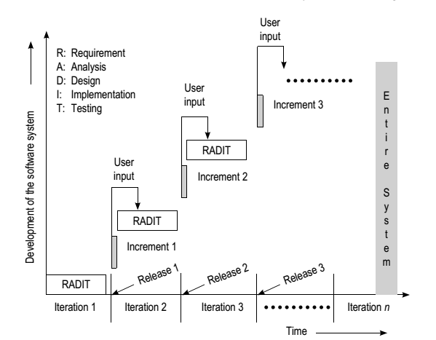
Iterative and Incremental Development

Slide 39
Iterative and Incremental Development
In iterative and incremental development, the software system is built through a series of time-boxed development cycles—iterations—leading to tangible and testable additions to the overall system functionality—increments.
This is an expedient model for building systems with initial ambiguity of scope and changing requirements.

Slide 40
The Agile Manifesto
“We are uncovering better ways of developing software by doing it and helping others do it. Through this work we have come to value:
Individuals and interactions over Processes and tools
Working software over Comprehensive documentation
Customer collaboration over Contract negotiation
Responding to change over Following a plan
That is, while there is value in the items on the right, we value the items on the left more”
http://agilemanifesto.org/ February 2001

Slide 41
12 Agile Principles
Customer satisfaction by rapid delivery of useful software
Welcome changing requirements, even late in development
Working software is delivered frequently (weeks rather than months)
Close, daily cooperation between business people and developers
Projects are built around motivated individuals, who should be trusted
Face-to-face conversation is the best form of communication (co-location)
Working software is the principal measure of progress
Sustainable development, able to maintain a constant pace
Continuous attention to technical excellence and good design
Simplicity—the art of maximizing the amount of work not done—is essential
Self-organizing teams
Regular adaptation to changing circumstance

Slide 42
Cohort Exercise 2 (5 min)
You have a sense of the course project by now. If you don’t, please make sure you do ☺
Read the Agile manifesto and principles and discuss with your team on what it means in terms of developing your project.

Slide 43
What is the Agile Method?
Click Here

Slide 44
Agile Method: Case Study
Click Here

Slide 45
Agile Method: Case Study
Click Here

Slide 46
Cohort Exercise 3 (10 min)
You have a sense of the course project by now. If you don’t, please make sure you do ☺
On the basis of what we have discussed so far, which methodology do you think would be suitable for developing your class project? Agree on some timeline on some milestones.

Slide 47
In terms of timeline, how we know how much effort and time a software development project needs?

Slide 48
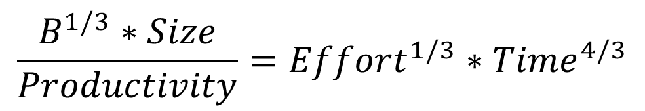
The Software Equation
$$\frac{B^{1/3}∗Size}{Productivity}={Effort}^{1/3}∗{Time}^{4/3}$$
The models basis was formed through analysis of productivity data collected from over 4000 modern day software development projects.^{[1]}
The software equation was derived from thePutnam-Norden-Rayleigh Curve which can be used to show the non-linear correlation between time to complete the project and applied human effort.^{[2]}

Slide 49
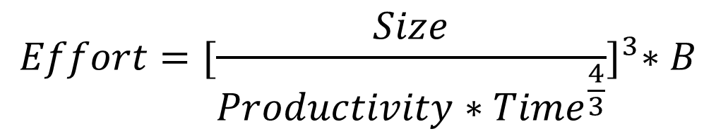
Solving for effort
$$Effort={[\frac{Size}{Productivity∗{Time}^{\frac{4}{3}}}]}^{3}∗B$$
Effort: project effort measured in person-months or person-years
Size: a lines of code estimate for the project
Time: length of project measured in months or years
B: a special skills factor
Productivity: a productivity parameter (depending on your team)

Slide 50
Defining B
B, the special skills factor, is related to the size of the product.
B Value | Size of Project
0.16 | 5-15K
0.18 | 20K
0.28 | 30K
0.34 | 40K
0.37 | 50K
0.39 | > 50K

Slide 51
Defining Productivity
Research from the collected productivity data supplies initial values for productivity determined by the type of software being developed.
Productivity Value | Description
2,000 | Real time embedded software
10,000 | Telecommunication software
12,000 | Scientific software
28,000 | Business system applications

Slide 52
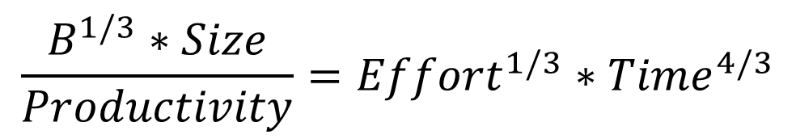
Quick Question
$$\frac{B^{1/3}∗Size}{Productivity}={Effort}^{1/3}∗{Time}^{4/3}$$
What is the relationship before time and effort in the equation?

Slide 53
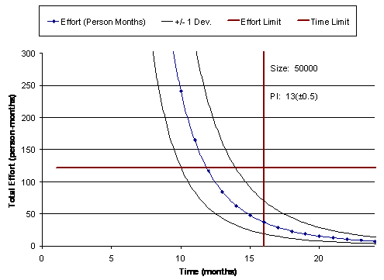

Slide 54
Impossible zones

Slide 55
You can only operate here

Slide 56
In case you have not noticed, this
is just an example. You do not have 15 months, not even
15 weeks!
You can only operate here

Slide 57
You can pour more effort into less time, but there
are limits … ☹

Slide 58
Cohort Exercise 4 (10 min)
Your project needs to be completed in 3 months. The estimated size of the system you are developing is 20,000 LOC.
Find out how much effort your team will need (assume productivity = 1200).
The team members decide to take a break during recess week (0.25 month). Is it wise?
Amongst the following choices, select the measure(s) you feel are most appropriate for your team to meet the original deadline and have the planned break.
Add two new members to the team immediately?
Every member of the team work longer hours each day?
Re-estimate the size of the system to be lower than 20,000 LOC?

Slide 59
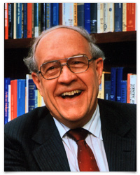
This week’s reading
Brooks, Frederick. P., Jr. (April 1987). "No Silver Bullet: Essence and Accidents of Software Engineering". Computer 20 (4): 10–19. doi:10.1109/MC.1987.1663532
http://tinyurl.com/c682zju

Slide 60
References
Datta, Subhajit , 2010. Software Engineering: Concepts and Applications. Oxford University Press. (ISBN 978-0-19-569656-1)
Ulrich, Karl T. , 2011. Design: Creation of Artifacts in Society. University of Pennsylvania. (ISBN 978-0-9836487-0-3)
Brooks, Frederick P. , 2010. The Design of Design: Essays from a Computer Scientist. Addison-Wesley Professional. (ISBN - 978-0201362985)
Putnam, Lawrence H.; Ware Myers (2003). Five core metrics : the intelligence behind successful software management. Dorset House Publishing. (ISBN 0-932633-55-2.)

Slide 61
Homework This Week
Meet and discuss with your group on what your App is going to be.
Meet and discuss with your group on how you plan to finish the project within the deadline.

